Slide 1
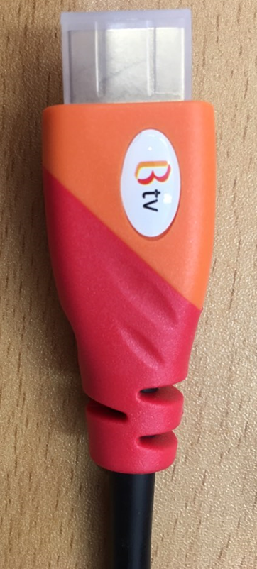
Head of HDMI Cable
SKB request to make a head of HDMI Cable such as above picture
If possible, I will ask SKB to information of color, an so on.
If not possible, please let us know the reason, I should send SKB to this reason

Slide 2
Size
4.5 mm
1.7 mm
14 mm
SK broadband
2.3mm
1.5mm

Slide 3
Location
High Speed HDMITM
Cable with Ethernet E210576 SU AWM STYLE 20276 80ºC 30V VW-1 SK Broadband
A sentence of this area is an example that I just write it I refer to your FXN’s HDMI cable sample.
I just write full sentence for location of SK Broadband logo.
You don’t need to mark this sentence to directly.
SK Broadband logo is at the end of the sentence.

Slide 4
The others
The others specification (ex) Font, gab of each character an so on)
can be decide by FXN
If SK Broadband logo is same to the other sentence or character
in HDMI Cable, it is OK

